Slide 1
Objective of Statistical process control
The main objective of Statistical Process Control (SPC) is to ensure consistent quality by monitoring and controlling processes to minimize variation and prevent defects. It achieves this by using statistical techniques to detect deviations in real-time, allowing for immediate corrective action before faulty products are made. Key goals include improving quality, reducing costs from waste and rework, and increasing customer satisfaction.
Statistical Process Control (SPC) is a data-driven methodology that uses statistical analysis to monitor, control, and improve manufacturing and other business processes. The primary goal is to ensure a process operates consistently and efficiently by identifying and addressing unusual variations in real-time.
Key Concept of SPC
Process variation: SPC is built on the principle that all processes have a degree of natural variation. This variation is classified into two types:
Common cause variation: Predictable, random fluctuations that are inherent to a stable process. This "background noise" indicates the process is in statistical control.
Special cause variation: Unpredictable, non-random variations caused by specific, identifiable external factors, such as machine failure, human error, or a new batch of materials.

Slide 2
UNIT OBJECTIVE
Prevention over detection: SPC focuses on proactively preventing defects by monitoring a process in real-time, rather than inspecting products after they have been made.
Control vs. specification limits: Control limits are calculated from the process's historical data and reflect its actual performance. Specification limits, in contrast, are the required boundaries set by customer or product design requirements.
Process capability: An analysis that evaluates whether a process is inherently capable of producing output that meets the customer's specified requirements.
Benefits of using SPC
Reduced costs: Minimizes waste, rework, and warranty claims by catching problems early in the process.
Improved quality and productivity: Leads to more consistent products and optimizes processes, increasing overall efficiency.
Enhanced decision-making: Provides clear, data-driven insights into process performance rather than relying on guesswork.
Regulatory compliance: Helps document process stability, providing proof of robust quality procedures for audits.
Continuous improvement: Fosters a culture of ongoing process enhancement, a core component of management strategies like Six Sigma and Lean manufacturing
SPC is a foundational tool across many industries, including:
Manufacturing
Healthcare
Finance
Aerospace
Food production

Slide 3
Primary tools in SPC
Control charts: The most common tool in SPC, these charts visually plot data points over time, along with a centerline and upper and lower control limits. They help distinguish between common and special cause variation. Examples include:
X-bar charts: Monitor the process mean.
R charts: Monitor the process range (variation).
P-charts: Track the proportion of defective items.
Other key tools (the "7 Quality Control Tools"): SPC is often used with other quality tools for a comprehensive analysis.
Pareto charts: Prioritize the most significant factors contributing to a problem.
Histograms: Show the frequency distribution of process data.
Cause-and-effect (fishbone) diagrams: Visually illustrate the potential causes of an issue.
Scatter diagrams: Examine the relationship between two variables.
Check sheets: Simple, structured forms for collecting and analyzing data.
Stratification: Segments data from different sources to simplify pattern identification.

Slide 4
QUALITY FUNCTION DEPLOYMENT
Quality Function Deployment is a planning tool used to fulfill customer expectations.
Quality Function Deployment focuses on customer expectations or requirements, often referred to as voice of the customer.
BENEFITS OF QFD
QFD TEAM :
There are two types of teams namely
1. Team for designing a new product
2. Team for improving an existing product
1. Improves Customer satisfaction
➢ Creates focus on customer requirements
➢ Uses competitive information effectively
➢ Prioritizes resources
➢ Identifies items that can be acted upon
2. Reduces Implementation Time
➢ Decreases midstream design changes
➢ Limits post introduction problems
➢ Avoids future development redundancies
3. Promotes Team Work
➢ Based on consensus
➢ Creates communication
➢ Identifies actions
4. Provides Documentation
➢ Documents rationale for design
➢ Adds structure to the information
➢ Adapts to changes (a living document)

Slide 5
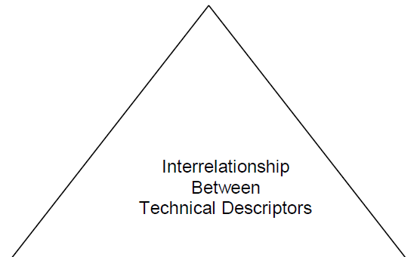
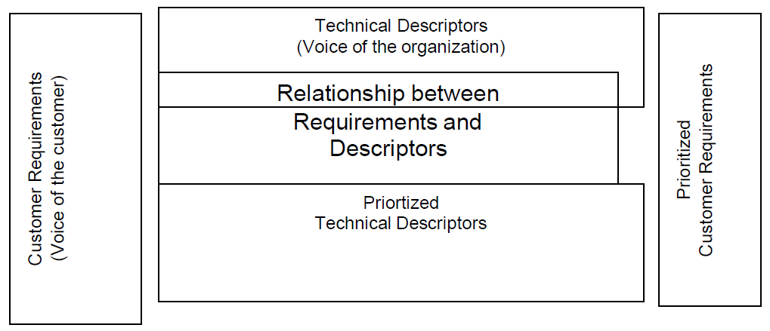
House of Quality
THE STEPS IN BUILDING A HOUSE OF QUALITY ARE :
1. List Customer Requirements (WHAT’s)
2. List Technical Descriptors (HOW’s)
3. Develop a Relationship Matrix Between WHAT’s and HOW’s
4. Develop an Inter-relationship Matrix between HOW’s
5. Competitive Assessments
a. Customer Competitive Assessments
b. Technical Competitive Assessments
6. Develop Prioritized Customer Requirements
7. Develop Prioritized Technical Descriptors

Slide 6
Taguchi Introduction
INTRODUCTION
Taguchi Methods is a statistical methods developed largely by GENICHI
TAGUCHI to improve quality of manufactured goods.
• The philosophy of off-line quality control.
• Innovations in the design of experiments.
Formula to find Taguchi’s Loss Fn
Taguchi uses Quadratic Equation to determine loss Curve
L (x) = k (x-N)²
Where L (x) = Loss Function,
k = C/d² = Constant of proportionality,
where C – Loss associated with sp limit
d - Deviation of specification from target value
x = Quality Features of selected product,
N = Nominal Value of the product and
(x-N) = Tolerance
Taguchi quality loss function
Taguchi Loss Function Definition
Taguchi defines Quality as “the loss imparted by the product to society from the time the
product is shipped.”
LOSS = Cost to operate,
Failure to function, maintenance and repair cost, customer satisfaction, poor design.
Product to be produced “being within specification”
Taguchi’s Vs Traditional Approach
Taguchi’s Quadratic Quality Loss Function
Quality Loss Occurs when a product’s deviates from target or nominal value.
Deviation Grows, then Loss increases.
Taguchi’s U-shaped loss Function Curve.

Slide 7
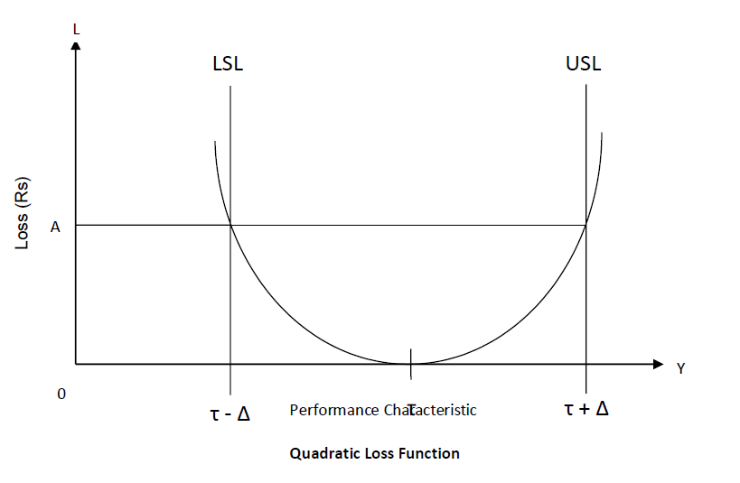
Taguchi quality loss function
Problem
A part dimension on a power tool is specified as 32.25±0.25.Company records show±0.25 exceeded & 75% of the returned fo replacement. Cost of replacement is Rs.12,500.Determine k & QLF.
Solution : Expected Cost of repair
C = 0.75(12500) = Rs 9,375
k = C/d²= 9375/(90.25)² = Rs 1,50,000
QLF =L (x) 1,50,00(x-N)
Taguchi’s Quality Loss Function concept combines cost, target and variation in one metric with specifications being of secondary importance.
Taguchi has defined quality as the loss imparted to society from the time a product is shipped.
Societal losses include failure to meet customer requirements, failure to meet ideal performance and harmful side effects.
CUSTOMERS PERCEIVE QUALITY AS MEETING THE TARGET RATHER THAN JUST MEETING THE SPECIFICATIONS.
There are three common quality loss functions
1. Nominal - the - best.
2. Smaller - the - better.
3. Larger - the - better.
4. NOMINAL – THE – BEST : Although Taguchi developed so many loss functions,
many situations are approximated by the quadratic function which is called the Nominal
– the – best type.

Slide 8
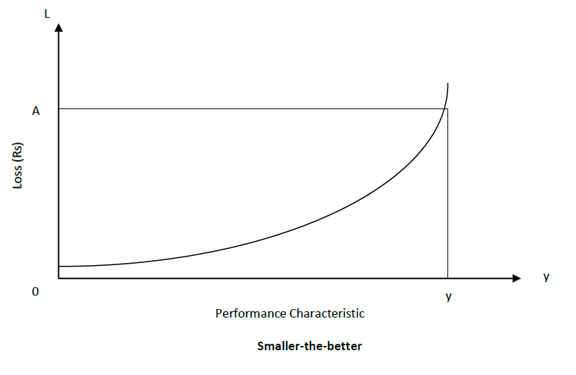
Taguchi quality loss function
The quadratic function is shown in figure. In this situation, the loss occurs as soon as the
performance characteristic, y, departs from the target τ.
At τ, the loss is Rs. 0.
At LSL (or) USL, the loss is Rs. A.
The quadratic loss function is described by the equation L = k (y - τ) 2.
Where,
L = cost incurred as quality deviates from the target.
y = Performance characteristic
τ = target
k = Quality loss coefficient.
The loss coefficient is determined by setting Δ = (y – τ), the deviation from the target. When Δ is
the USL (or) LSL, the loss to the customer of repairing (or) discarding the product is Rs. A.
Thus, K = A / (y – τ)2 = A / Δ2 .
SMALLER – THE – BETTER :
The following figure shows the smaller – the – better concepts.
The target value for smaller – the – better is 0. There are no negative values for the performance characteristic.
The radiation leakage from a microwave appliance, the response time for a computer, pollution from an automobile, out of round for a hole etc. are the performance characteristics for this concept.
LARGER – THE – BETTER :
The following figure shows the concept of the Larger – the – better.

Slide 9
Total Productive Maintenance (TPM)
OBJECTIVES OF TPM :
1. To maintain and improve equipment capacity.
2. To maintain equipment for life.
3. To use support from all areas of the operation.
4. To encourage input from all employees.
5. To use teams for continuous improvement.
Total Productive Maintenance (TPM) is defined as keeping the running plant and equipment at its highest productive level with the co-operation of all areas of the organization.
Predictive and Preventive maintenance are essential to building a foundation for a successful TPM environment. Predictive Maintenance is the process of using data and statistical Loss (Rs) tools to determine when a piece of equipment will fail. Preventive Maintenance is the process of periodically performing activities such as lubrication on the equipment to keep it running.

Slide 10
TPM PHILOSOPHY – CONCEPT OF TPM :
Total Productive Maintenance (TPM) is an extension of the Total Quality Management (TQM) philosophy to the maintenance function.
TPM has the following steps:
1. Management should learn the new philosophy of TPM.
2. Management should promote the new philosophy of TPM.
3. Training should be funded and developed for everyone in the organization.
4. Areas of needed improvement should be identified.
Loss measurements to identify improvement needs are
▪ Down time losses
▪ Reduced speed losses
▪ Poor quality losses
5. Performance goals should be formulated.
6. An implementation plan should be developed.
7. Autonomous worth groups should be established.

Slide 11
FAILURE MODE AND EFFECTS ANALYSIS (FMEA)
FMEA is an analytical technique that combines the technology and experience of people in identifying foreseeable failure modes of a product or process and planning for its elimination.
FMEA is a “before-the-event” action requiring a team effort to easily and inexpensively alleviate changes in design and production.
It is a group of activities comprising the following :
1. Recognize the potential failure of a product or process.
2. Identify actions that eliminate / reduce the potential failure.
3. Document the process.
Two important types of FMEA are
➢ Design FMEA
➢ Process FMEA
Failure Mode
A Failure Mode is:
⚫ The way in which the component, subassembly, product, input, or process could
fail to perform its intended function
⚫ Failure modes may be the result of upstream operations or may cause
downstream operations to fail
⚫ Things that could go wrong
Why
⚫ Methodology that facilitates process improvement
⚫ Identifies and eliminates concerns early in the development of a process or design
⚫ Improve internal and external customer satisfaction
⚫ Focuses on prevention
⚫ FMEA may be a customer requirement
⚫ FMEA may be required by an applicable Quality System Standard
There are several types of FMEA : design FMEA, process FMEA, equipment FMEA, maintenance FMEA, concept FMEA, service FMEA, system FMEA, environmental FMEA, and others.

Slide 12
INTENT OF FMEA :
➢ Continually measuring the reliability of a machine, product or process.
➢ To detect the potential product - related failure mode.
➢ FMEA evaluation to be conducted immediately following the design phase.
FMEA TEAM :
Engineers from- Assembly- Manufacturing- Materials - Quality - Service- Supplier-Customer.
Methodology used for FMEA
FMEA Procedure
1. For each process input (start with high value inputs), determine the ways in which the
input can go wrong (failure mode)
2. For each failure mode, determine effects
⚫ Select a severity level for each effect
3. Identify potential causes of each failure mode
⚫ Select an occurrence level for each cause
4. List current controls for each cause
⚫ Select a detection level for each cause
5. Calculate the Risk Priority Number (RPN)
6. Develop recommended actions, assign responsible persons, and take actions
⚫ Give priority to high RPNs
⚫ MUST look at severities rated a 10
7. Assign the predicted severity, occurrence, and detection levels and compare RPNs
BENEFITS OF FMEA:
Having a systematic review of components failure modes to ensure that any
failure produces minimal damage.
➢ Determining the effects of any failure on other items.
➢ Providing input data for exchange studies.
➢ Determining how the high-failure rate components can be adapted to high-
reliability components.
➢ Eliminating / minimizing the adverse effects that failures could generate.
➢ Helping uncover the misjudgements, errors etc.
➢ Reduce development time and cost of manufacturing.

Slide 13
FMEA Inputs and Outputs
Severity,Occurrence, and Detection
o Severity
• Importance of the effect on customer requirements
o Occurrence
• Frequency with which a given cause occurs and
creates failure modes
o Detection
• The ability of the current control scheme to detect
or prevent a given cause
Rating Scales
⚫ There are a wide variety of scoring “anchors”, both quantitative or qualitative
⚫ Two types of scales are 1-5 or 1-10
⚫ The 1-5 scale makes it easier for the teams to decide on scores
⚫ The 1-10 scale may allow for better precision in estimates and a wide
variation in scores (most common)
⚫ Rating Scales
⚫ Severity
1 = Not Severe, 10 = Very Severe
⚫ Occurrence
1 = Not Likely, 10 = Very Likely
⚫ Detection
1 = Easy to Detect, 10 = Not easy to Detect
⚫ Risk Priority Number (RPN)
RPN is the product of the severity, occurrence, and detection scores.
Explain with an example Process FMEA document.
Process FMEA is an analytical Technique utilized by a manufacturing Responsible Engineering Team as a means to assure that , to the extent possible, potential failure modes and associated causes /mechanisms have been considered and addressed.
FMEA DOCUMENTATION :
The purpose of FMEA documentation is
➢ To allow all involved Engineers to have access to others thoughts
➢ To design and manufacture using these collective thoughts (promotes team
approach)

